Slide 1
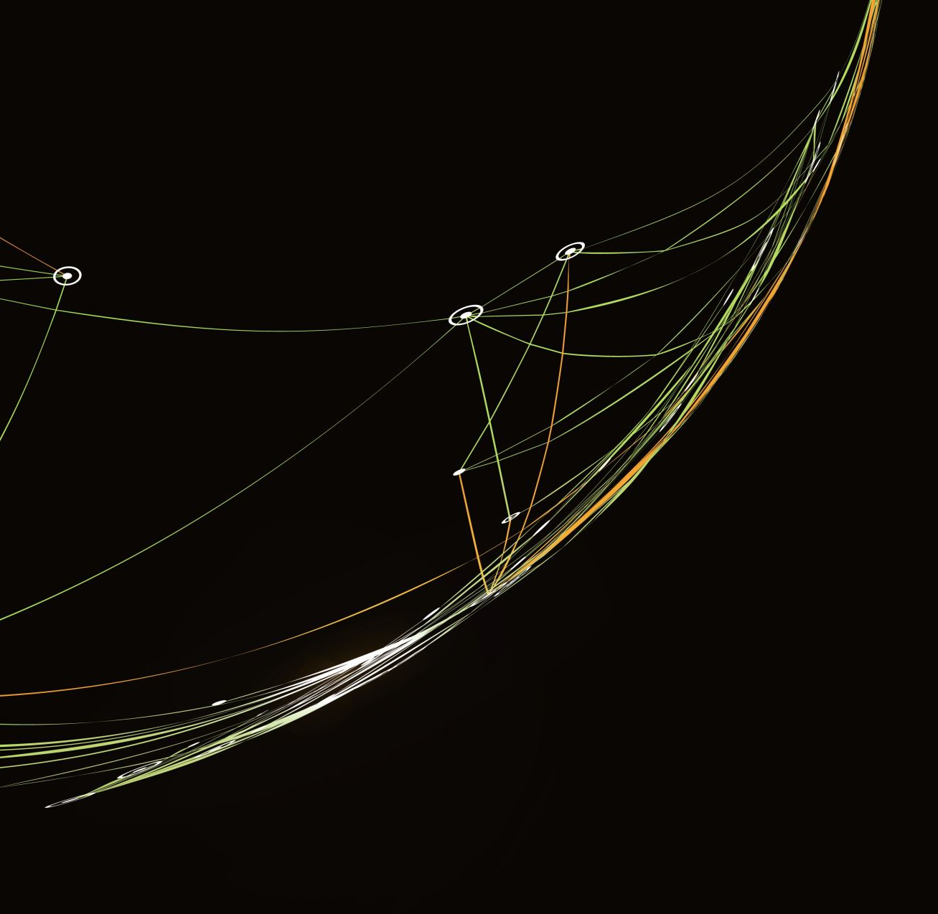
Group 26 Interim Report
By: Julia Bozzino, Ganesh Gopalkrishna Hegde, and Robin Kneepkens

Slide 2
Current State of Project
What we’ve done so far:
We have a nice interface with our dataset now.
We can train our first baseline network (ResNet)
We implemented our core technique SPP as a custom pytorch module
What we didn’t do (goals from our proposal):
Exploratory data analysis of dataset. This didn’t seem so necessary anymore. Perhaps before actually training.
Implement our BirdSpotter network. This is only partially done.

Slide 3
Plans
Near-future:
Figure out how to train our networks on the GPU cloud
Fully implement our BirdSpotter and BirdClassifier network
Start training!
Longer term:
Gather data for the report
Write the report

Slide 4
Problems
None really. Progress has been pretty smooth.

